Slide 1
Dolfin Technology
Web Scraping Stock Data
J Tarness, Andrew Hogan, Xu Duoduo
Notes:
J

Slide 2
Introduction
Notes:
J

Slide 3
Project Description
This project aims to perform the use of web scraping stock market data to in turn use that data to send email messages to users about stock market tips and insights within a network program
An overarching goal is to provide up to date, reliable, and consistent stock information to both experienced and beginning investors
All users of the program should find use in the information provided regardless of prior stock experience and future intentions with the stock market
Notes:
J

Slide 4

Program Registration
The client will access the application that is running on a virtual machine through a web browser which will have access to both API’s
The web server directly communicates with the Alpaca Trade API that holds stock information and eventually formats emails to the user
An additional Spring API also holds all client profile information
In order to initially subscribe to the application, the client uses a browser to connect to a registration/sign-in page
After entering profile information, the user will then begin receiving emails with stock updates and tips
In the future, the application will also provide the opportunity for users to be placed into groups based on their investing preferences and tendencies
Notes:
Andrew

Slide 5


Program Features
1. Directly email users information about stock tips and insights
2. Users are provided with the best platforms to invest in with the least cost
3. Create investing groups based on investing preferences
4. Users provide their email and phone number to subscribe to the market updates
5. Users log into a full website as a place to gain more details from the information sent to them
Notes:
Andrew

Slide 6
Creation of the Program
Notes:
J

Slide 7
Design and System Architecture
PYTHON SERVER
GUI
STOCK API (ALPACA)
USER API
SMTP PROTOCOL
EMAIL TO USER
Notes:
J

Slide 8
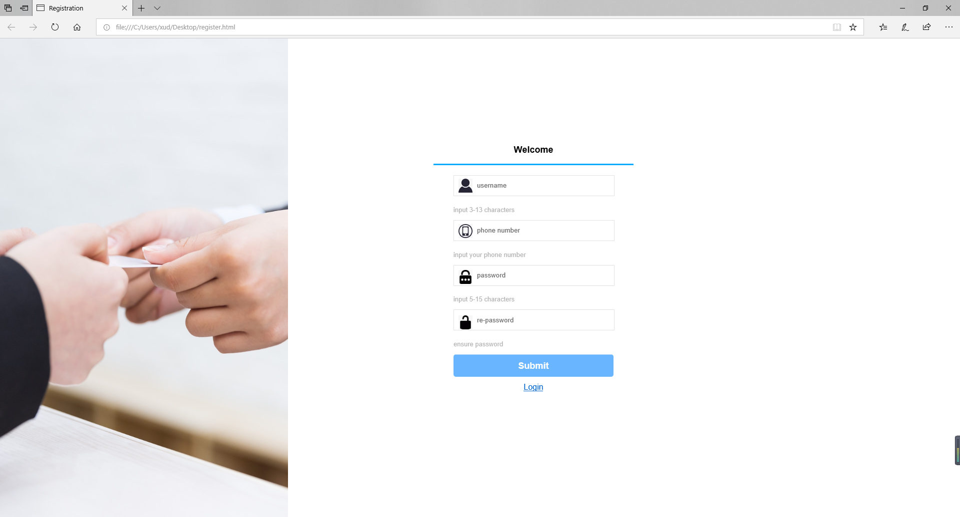
GUI Implementation
Notes:
Ted

Slide 9
Client Profile/Program Workflow
Using the previously shown registration page, the client inputs the required information to register their profile on the site. The client will then automatically receive all future stock updates from the API. This is the registration stage.
Once the user gains access to the site, the API fetches updated stock information for a few stocks at a time and stores this information along with profile tokens to differentiate each client. This is the storing stage.
The program uses its stored information (user profile and associated API stock data) to prepare for the sending process to the client. This is the retrieval stage.
The retrieved information is formatted into a readable message that is then sent to the user via email. This is the delivery stage.
Notes:
Andrew

Slide 10
Challenges and Solutions
Webscraping altered for a spring API that stores all relevant user information for each client profile (Alpaca Trade API used to obtain stock market information)
The issue of connecting GUI and client program using socket programming solved with the new Alpaca Trade API and JQuery class descriptions
Deciphering between texting and emailing updates: texting protocols seemed more extensive than SMTP implementation for emails that resembled class exercises
Notes:
J

Slide 11

Program Demo
Notes:
J

Slide 12

Future Work
Notes:
Ted

Slide 13
Group Investing Capability
The biggest improvement to the program in the future would be in creating the capability for investing groups within the program
As previously mentioned, a new user will be asked about their preference in networking with other users of the program along with their preferred method to receive information
Users selecting “yes” to being placed in an investing group will have their investing tendencies matched together with other clients based on different criteria
The members of each newly formed group will receive the same stock information and will have the ability to chat back and forth about investing ideas
Notes:
Ted

Slide 14
Texting Protocols
The original intention for the program was to allow the user to choose whether to receive stock updates via email or text messages
Since only email messages through SMTP are currently functioning, getting the texting protocols to function is logical for future work
To achieve this, a component of the API that sends SMS messages must be implemented in connection with the API holding client information and therefore phone numbers
Notes:
Ted

Slide 15
Implementation of a Full Website
In addition to the registration page that gathers information about each new user, a fully dedicated website could also be created
The website would house enhanced stock information that connects directly with updated trends to give users one place to browse a multitude of stock data
Account information and any investing groups for each user will also be displayed within the website
The website will not act as a replacement for the text updates, as this is the more convenient way to gain information, it will only provide another option for users with more time to browse for information
Notes:
J

Slide 16

Questions
Notes:
All

